Slide 1

Spinning Dream to Reality

Slide 2

Our Profile
bangladesh@e-orchids.com | www.e-orchids.com

Slide 3

Started in 2004 in India, 2008 in Bangladesh, 2010 in USA.
Specialized in Web Designing and Multimedia
Top Notch Professional Designers
Customer Satisfaction is our prime base
Year 2006 plunged into the field of Online Software's.
bangladesh@e-orchids.com | www.e-orchids.com

Slide 4
Our Credentials
bangladesh@e-orchids.com | www.e-orchids.com

Slide 5

Developed more than 100+ websites
Developed more than 30+ branding
Developed more than 3+ Online ERP Software
Having Clients in 10+ Countries across different Continents.
And many more…
bangladesh@e-orchids.com | www.e-orchids.com

Slide 6
Our Process
bangladesh@e-orchids.com | www.e-orchids.com

Slide 7
Core Process
Discover
Define
Develop
Deliver
bangladesh@e-orchids.com | www.e-orchids.com

Slide 8

Our approach towards client is highly collaborative
We create a fresh perspective & fuel innovation in service
Discover - Define - Develop - Deliver is our Core System
Customer Satisfaction has always been our guiding principle
bangladesh@e-orchids.com | www.e-orchids.com

Slide 9
Our Service
bangladesh@e-orchids.com | www.e-orchids.com

Slide 10

Impeccable projects and tangible results on time & budget
Our Quality of Service would be exceptional in its Class
We work with Clients regularly to boost their growth
Projects delivered for smaller and large corporations
bangladesh@e-orchids.com | www.e-orchids.com

Slide 11
Our Capabilities
bangladesh@e-orchids.com | www.e-orchids.com

Slide 12




Logo Designing
Web Hosting
Web Design & Dev.
Print Designs
bangladesh@e-orchids.com | www.e-orchids.com

Slide 13




Hoardings
3D Modeling
3D Product Modeling
Corporate
Presentations
bangladesh@e-orchids.com | www.e-orchids.com

Slide 14
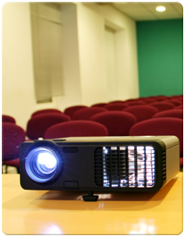



Desktop
Presentations
Online Software
E Commerce
CMS
Content Management System
bangladesh@e-orchids.com | www.e-orchids.com

Slide 15
Group Companies
bangladesh@e-orchids.com | www.e-orchids.com

Slide 16



Aspirant Labs
Software Services
Global Exim Corp.
Export Services
GIFT
N.G.O
bangladesh@e-orchids.com | www.e-orchids.com

Slide 17
Clients-International
bangladesh@e-orchids.com | www.e-orchids.com

Slide 18




Luna Road LLC
USA
ERP School
UK
ERP labs
UK
Professional Couriers
Singapore
View More
bangladesh@e-orchids.com | www.e-orchids.com

Slide 19
Clients-Domestic
bangladesh@e-orchids.com | www.e-orchids.com

Slide 20



Max New York Life
Chennai, India
Professional Couriers
Chennai, India
Repute Express
Chennai, India
IG Family Resorts
Chennai, India
View More
bangladesh@e-orchids.com | www.e-orchids.com

Slide 21
Recent Portfolios
bangladesh@e-orchids.com | www.e-orchids.com

Slide 22
Branding
bangladesh@e-orchids.com | www.e-orchids.com

Slide 23
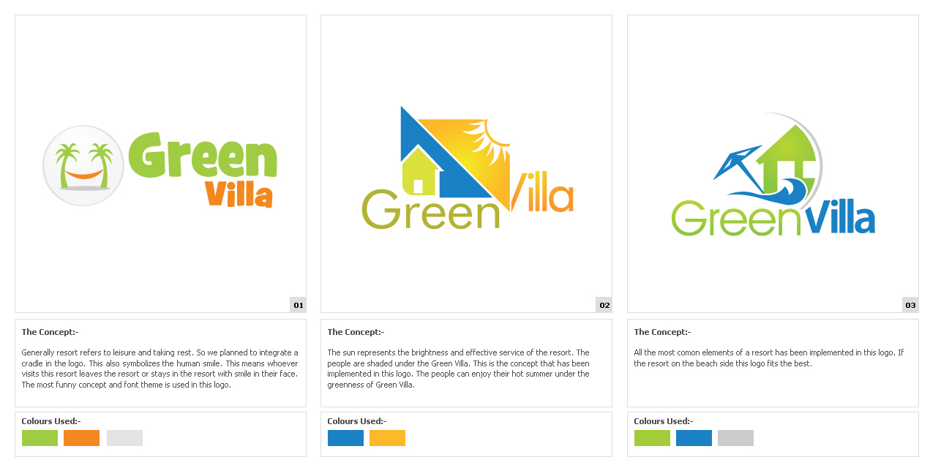

Name of the Client :
Green Villa Resort
Country :
Bangladesh
bangladesh@e-orchids.com | www.e-orchids.com

Slide 24

Name of the Client :
Mullar Tex Ltd.
Country :
Bangladesh
bangladesh@e-orchids.com | www.e-orchids.com

Slide 25
Name of the Client :
Computer Marketing
Country :
United Kingdom
bangladesh@e-orchids.com | www.e-orchids.com

Slide 26

Name of the Client :
Mukhtaar Garments
Country :
Chennai, India
bangladesh@e-orchids.com | www.e-orchids.com

Slide 27

Name of the Client :
Islamic Life Style Park
Country :
Chennai, India
bangladesh@e-orchids.com | www.e-orchids.com

Slide 28
View More Branding Works
bangladesh@e-orchids.com | www.e-orchids.com

Slide 29
Web Designing
bangladesh@e-orchids.com | www.e-orchids.com

Slide 30

Name of the Client :
Luna Streetlight
URL :
www.lunastreetlight.com
bangladesh@e-orchids.com | www.e-orchids.com

Slide 31

Name of the Client :
IG Resort
URL :
www.igresorts.com
bangladesh@e-orchids.com | www.e-orchids.com

Slide 32
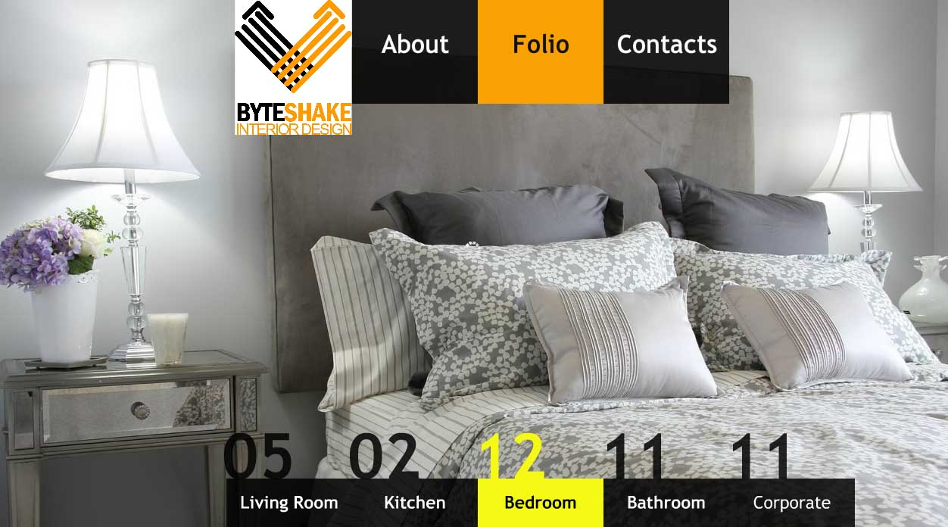
Name of the Client :
Byteshake Interior Design
URL :
www.byteshakedesign.com
bangladesh@e-orchids.com | www.e-orchids.com

Slide 33
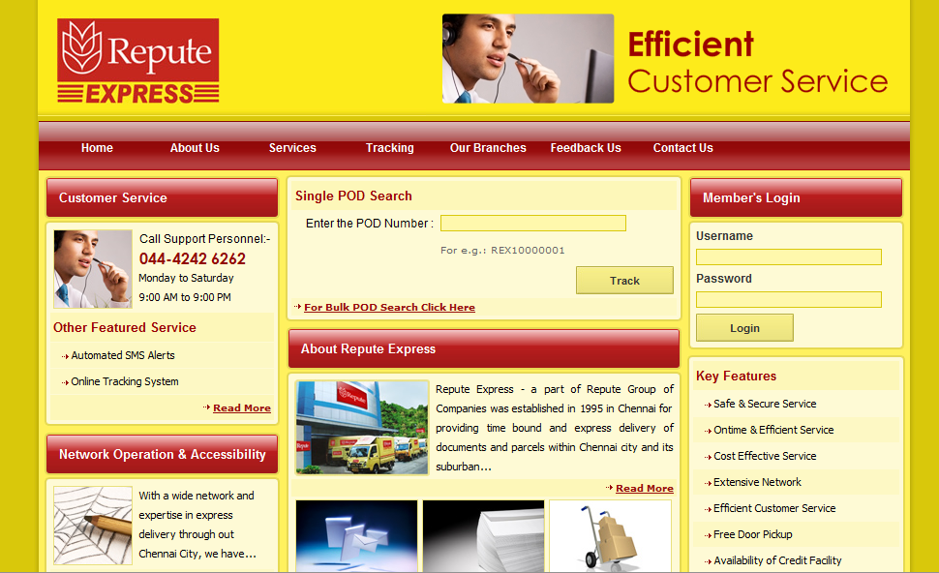
Name of the Client :
Repute Express
URL :
www.reputeexpress.net
bangladesh@e-orchids.com | www.e-orchids.com

Slide 34

Name of the Client :
ERP School & Solutions
URL :
www.erpschool.co.uk
bangladesh@e-orchids.com | www.e-orchids.com

Slide 35
View More Web Designing Works
bangladesh@e-orchids.com | www.e-orchids.com

Slide 36
Print Designs
bangladesh@e-orchids.com | www.e-orchids.com

Slide 37


Name of the Client :
Mouthful & Flame Grill
Purpose :
Hording & Printing Design
bangladesh@e-orchids.com | www.e-orchids.com

Slide 38

Name of the Client :
Mega Bite
Purpose :
Logo & Printing Design
bangladesh@e-orchids.com | www.e-orchids.com

Slide 39

Name of the Client :
Repute Water
Purpose :
2010 Calendar Design
bangladesh@e-orchids.com | www.e-orchids.com

Slide 40

Name of the Client :
Axiom Academy
Purpose :
Campaign Posters
bangladesh@e-orchids.com | www.e-orchids.com

Slide 41

Name of the Client :
The Professional Couriers
Purpose :
Newspaper Campaign
bangladesh@e-orchids.com | www.e-orchids.com

Slide 42
View More Print Design Works
bangladesh@e-orchids.com | www.e-orchids.com

Slide 43
3D Works
bangladesh@e-orchids.com | www.e-orchids.com

Slide 44

View Work
Name of the Client :
Luna Road
Purpose :
Solar Light Night time Simulation
bangladesh@e-orchids.com | www.e-orchids.com

Slide 45

Name of the Client :
Luna Road
Purpose :
Product modeled in 3D
bangladesh@e-orchids.com | www.e-orchids.com

Slide 46

View Work
Name of the Client :
Eco Furn
Purpose :
3D Commercial Intro
bangladesh@e-orchids.com | www.e-orchids.com

Slide 47
View More 3D Works
bangladesh@e-orchids.com | www.e-orchids.com

Slide 48
Presentations
bangladesh@e-orchids.com | www.e-orchids.com

Slide 49
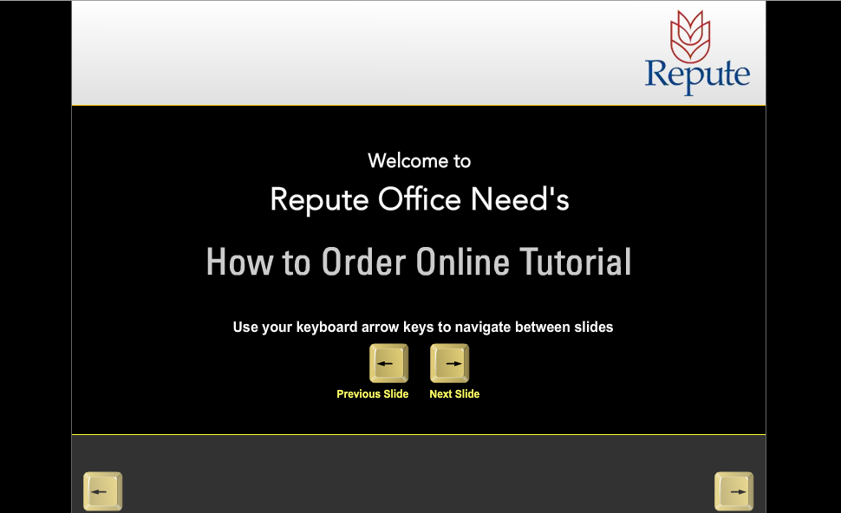
View Work
Name of the Client :
Repute Office Needs
Purpose :
Online Tutor
bangladesh@e-orchids.com | www.e-orchids.com

Slide 50

View Work
Name of the Client :
Axiom Academy
Purpose :
CD Presentation Intro
bangladesh@e-orchids.com | www.e-orchids.com

Slide 51
Our Offices
bangladesh@e-orchids.com | www.e-orchids.com

Slide 52


Head Office (India)
Bangladesh Office
City Center, 6th Floor,
Chennai-600 094.
Tamil Nadu, INDIA.
137/F, Jahanara Garden,
Green Road, Farmgate,
Dhaka-1215. Bangladesh.
Phone : +91-44-421 86 790
E-Mail : support@e-orchids.com
Hotline : 01758439935, 01750530055
E-Mail : bangladesh@e-orchids.com
bangladesh@e-orchids.com | www.e-orchids.com

Slide 53
Thank You
bangladesh@e-orchids.com | www.e-orchids.com

